Slide 1
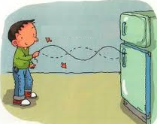

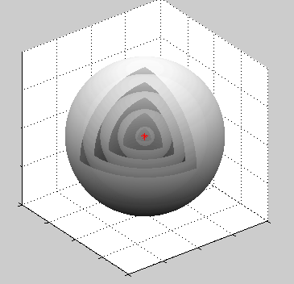
What is a wave?
Introduction to Waves
Waves can travel in 1, 2 or 3 dimensions!

Slide 2
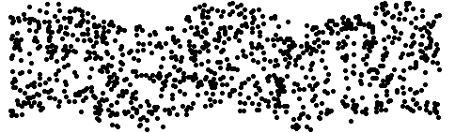
Types of 1D waves
Transverse Waves

Slide 3
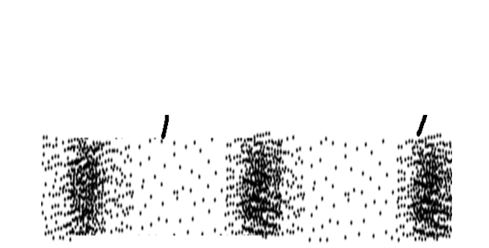
Longitudinal Waves
Water Waves

Slide 4
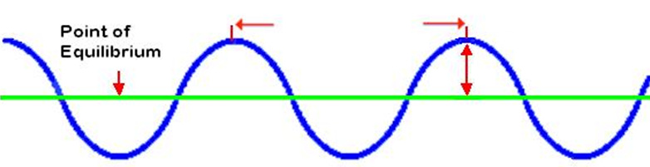
Wave Properties
Wavelength ( ) Units:
Amplitude ( ) Units:

Slide 5
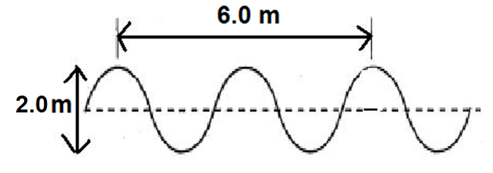
Example 1: For the wave below
a) State the wave type
b) Determine the amplitude (A)
c) Determine the wavelength (λ)
Answer:

Slide 6
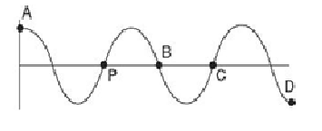
Phase-
Ex. 2: Which point(s) is/are in phase with point P?
Answer:

Slide 7
Period ( ): Units:
-
Frequency ( ): Units:
-
-
Calculating period and frequency:
Given N cycles counted over a time interval of Δt:
and

Slide 8
Ex. 3:
You are at the beach watching waves lap up against the shore. You count 5 waves lapping up every 2.0 seconds. What is the period and frequency?
Ans:

Slide 9
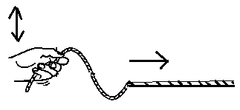
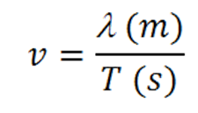
The Universal Wave Equation
Recall: Speed=distance or v= Δd
time Δ t
For a wave:
distance = length of one cycle (wavelength-λ)
time= time of one cycle (period T)
Speed equation becomes:

Slide 10


The Universal Wave Equation
Ex. 4:
You are at the beach watching waves lap up against the
shore. You count 12 waves lapping up every 15.0
seconds. What is the wave frequency?
b) You also notice that there is 3.50 m between successive crests of the wave. What is the wave speed?
Ans: a) 0.800 Hz b) 2.80 m/s

Slide 11
What determines Wave Speed?
The speed of a wave is determined by the material it travels in.
Example: The speed of waves travelling in a string is controlled by tension.
High tension= high speed
Low tension=low speed

Slide 12
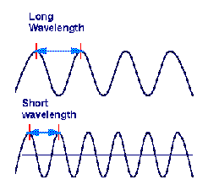
Relationship between wavelength and frequency:
For a given medium, wave speed, v, is constant!
Frequency and wavelength are inversely proportional!
f ↑, λ ↓
f ↓, λ ↑
Low frequency
High frequency

